Slide 1
eO-DMC
Training

Slide 2
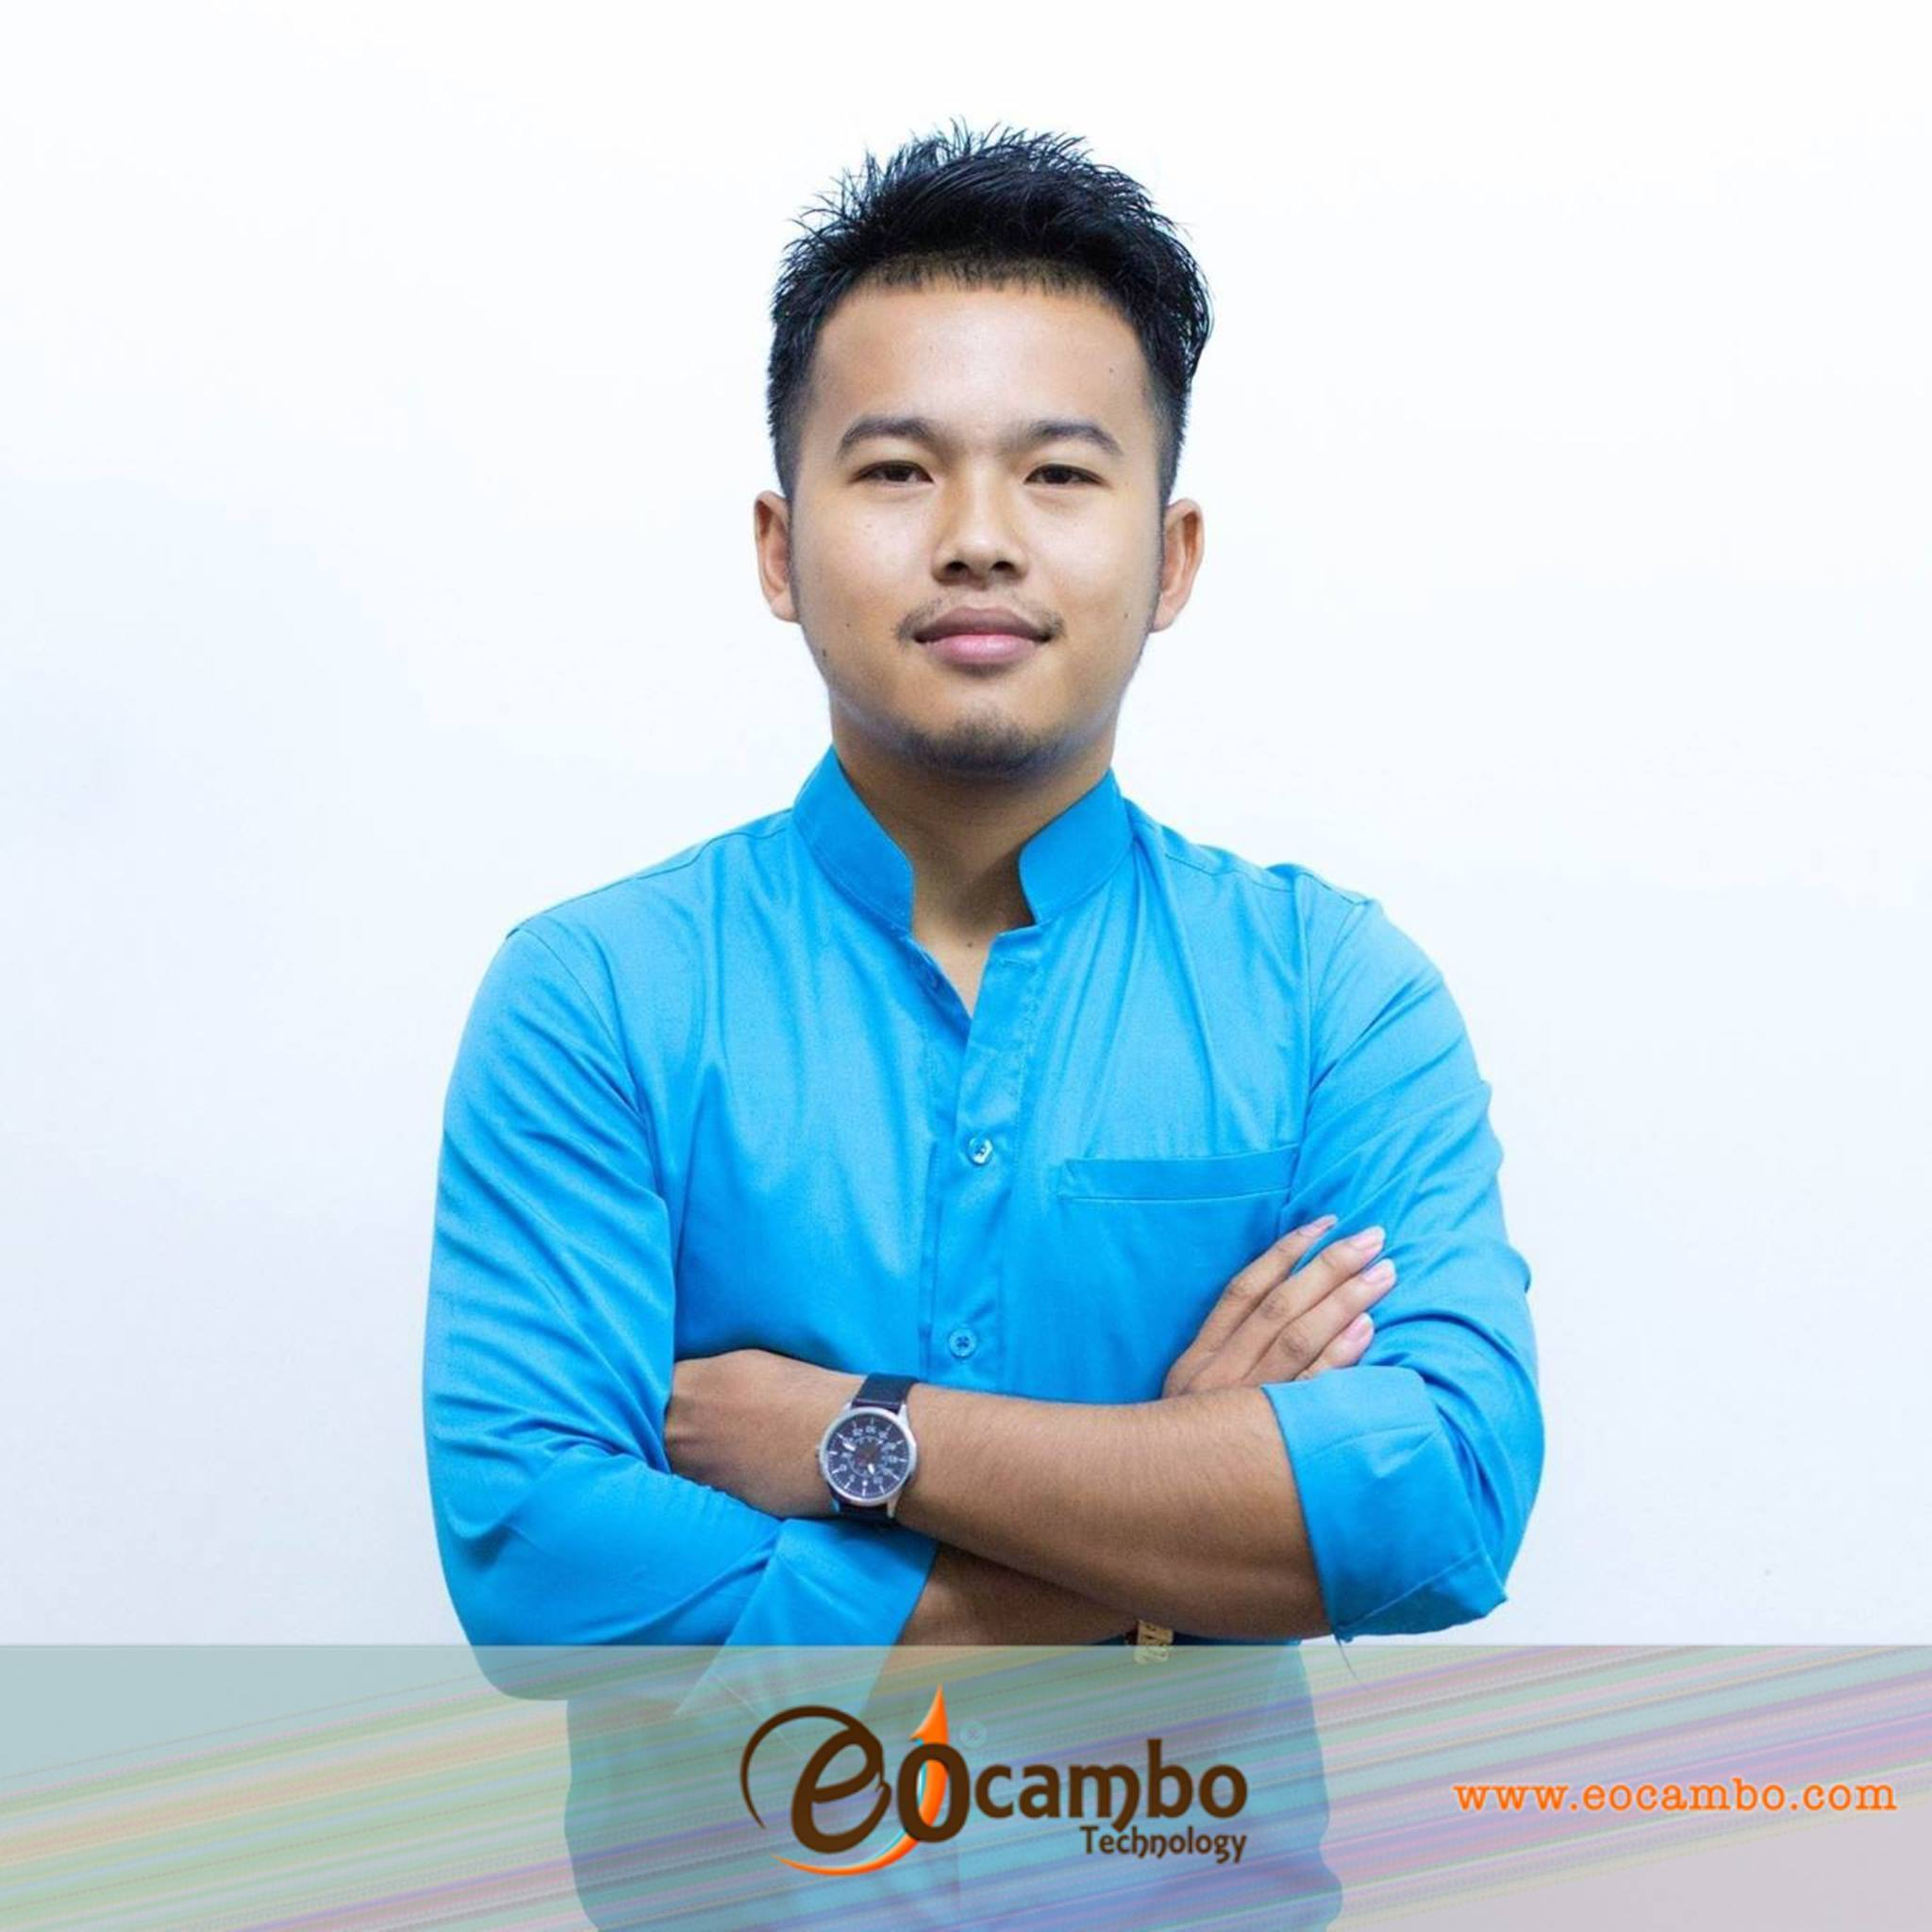
Hello!
I am Pov (Robaer)
I am a developer of eO-DMC.

Slide 3
eO-DMC
eO-DMC is the name of Tour Operator or Destination Management Company (DMC) System which help to working in the design and implementation to choose and select the best plan.
It’ll allows you manage your tour company operation.

Slide 4
Main Section
SETUP
7 of sub-functions
74 of child-functions
20 minutes
CONTACT
10 of sub-functions
60 of child-functions
20 minutes

Slide 5
SETUP

Slide 6
Setup is the main function used to create basic structure of your company data. Detailed data has to be entered into the system and is used to combine information needed for all functions of this system.
All functions in this system can’t be used if all data have not entered.

Slide 7
SETUP
Destination
Area
is the data that present about the region or a part of the world.
Country
is the data that present about the nation and occupying a particular territory.
City
is the data that present after country, use to specify the launch city in every country.
Place / Attraction
is the data that present attraction places for visiting in the city.
Location Type / Zone
is the data presented about a location where an attraction is within a city.
Specific Location
is the data that presents about the absolute location within the zone.

Slide 8
SETUP
Supplier
Hotel
is the function used to setup the specific detail about the hotel and services.
Transport
is the function used to setup the available transportation services with full detail and option for clients.
Guide
is the function used to setup the available guide services with full detail and option for clients.
Restaurant
is the function that is used to setup details of restaurants.
Other Service
is the function uses to setup the data that add up from other suppliers or service providers.
Cruise
is the function used to setup the specific detail about the cruise and services.

Slide 9
SETUP
Finance
Account Type
is used to setup the full group of sub accounts related to Finance operations in your company.
Chart of Account
is used to setup the specific type of account.
Tax
is used to setup the Tax section within the finance system.

Slide 10
SETUP
HR
Leave Type Name
used to setup the type of leave available to employees.
Leave Type Condition
used to set up the condition of leave for employees.
Leave Role
used to set up role of leaving job of employee.
Benefit Type
is used to setup the benefit that employees get from the company.

Slide 11
SETUP
Doc & Template
HR Document
used to create the name of documents relating to employees.
Marketing Template
is used to create Templates for promoting your business to clients.
Email Template
is used to create templates for sending email to Clients, Agency, Hotel, Supplier etc. to confirm bookings or give information.
Tour Name
is used to setup a Tour package that is provided from a supplier.
Document Format
used to set up an abbreviation for a type of document. All data will be used throughout the eO-DMC document ID.

Slide 12
SETUP
Data Option
Bank
Prefix
Currency
Branch
Payment Method
Payment Type
Credit Card
Language
Additional Charge
Market Type
Tariff Set
Agent Setup
Company Profile

Slide 13
SETUP
Group Permission
Group Permission is the function use to setup permission assign to each user by grouping functions symmetry with employee position.
The permission here is the right to access data in system which there are 4 ways like view, add, update and delete.
Every Group Permission had created will be used to assign to the users who are operating employees in the company.

Slide 14
CONTACT

Slide 15
Contact is the function used to set up information regarding employee, customer, agent, accommodation, transport, restaurant, tour, tour guide, and other services your company offers to clients.
All created profile are related to quotation & booking.

Slide 16
CONTACT
Employee
Employee used to create employee profile to show information of employee with full detail.

Slide 17
CONTACT
Customer
Customer is used to create a Customer profile that will contain full information and contact detail.

Slide 18
CONTACT
Agent
Info
is a function allows to update the basic information that you created.
Remark
use to add comment or some mention in profile.
Contact List
is used to create a contact list of employees who work with an Agent.
Bank Account
is used to set company bank account detail for current agent.
Price Method
is used to setup an adjustment to the system price for a product.
Assign To
is used to assign an employee who is allowed to deal with the agent..

Slide 19
CONTACT
Accommodation
Info
is a function allows to update the basic information that you created.
Facility
use to setup service that hotel provides the comfort and convenience in the hotel.
Room Type
used to create Room types available in a Hotel.
Child Policy
is the function used to setup the hotel policy for children.
Cancellation Policy
is used to create policy of cancellation reservations that have been booking.
FOC Policy
is the function that is used to create the Free of Charge conditions available in the Hotel.

Slide 20
CONTACT
Accommodation
Contact List
is used to create a contact list of employees who work with hotel.
Gallery Image
is the function used to create categories of images and to upload the images to each category for a hotel.
Bank Account
is used to set company bank account detail for current hotel.

Slide 21
CONTACT
Transport
Info
is a function allows to update the basic information that you created.
Facility
use to setup service that hotel provides the comfort and convenience in the transport.
Cancellation Policy
is used to create policy of cancellation reservations that have been booking.
Contact List
is used to create a contact list of employees who work with profile.
Bank Account
is used to set company bank account detail for current profile.
Gallery Image
is the function used to create categories of images and to upload the images to each category.

Slide 22
CONTACT
Transport
Vehicle
is the function used to create Vehicles available for a transport company and to upload images.

Slide 23
CONTACT
Restaurant
Info
is a function allows to update the basic information that you created.
Menu
is the function use to create menu of restaurant contain with the type of menu and images.
Cancellation Policy
is used to create policy of cancellation reservations that have been booking.
FOC Policy
is the function that is used to create the Free of Charge conditions available in the restaurant.
Child Policy
is the function used to setup the hotel policy for children.
Bank Account
is used to set company bank account detail for current restaurant.

Slide 24
CONTACT
Restaurant
Gallery Image
is the function used to create categories of images and to upload the images to each category.

Slide 25
CONTACT
Tour-Activity
Info
is a function allows to update the basic information that you created.
Service Name
is the function used to create actual Tour Activity information.
Cancellation Policy
is used to create policy of cancellation reservations that have been booking.
Child Policy
is the function used to setup the hotel policy for children.
FOC Policy
is the function that is used to create the Free of Charge conditions available in the company.
Contact List
is used to create a contact list of employees who work with profile.

Slide 26
CONTACT
Tour-Activity
Bank Account
is used to set company bank account detail for current company.
Gallery Image
is the function used to create categories of images and to upload the images to each category.

Slide 27
CONTACT
Guide
Info
is a function allows to update the basic information that you created.
Language
is the function that is used to create language skills of the Tour Guide.
Service
is the function that is used to create services available from a Tour Guide.
Bank Account
is used to set company bank account detail for current guide.
Gallery Image
is the function used to create categories of images and to upload the images to each category.

Slide 28
CONTACT
Cruise
Info
is a function allows to update the basic information that you created.
Facility
use to setup service that hotel provides the comfort and convenience in the hotel.
Itinerary
is the function used to create the tour itinerary for a Cruise.
Cancellation Policy
is used to create policy of cancellation reservations that have been booking.
FOC Policy
is the function that is used to create the Free of Charge conditions available in the cruise.
Child Policy
is the function used to setup the cruise policy for children.

Slide 29
CONTACT
Cruise
Cabin Type
is the function used to create the cabin, the type and category of each cabin available on a Cruise.
Contact List
is used to create a contact list of employees who work with profile.
Bank Account
is used to set company bank account detail for current cruise.
Gallery Image
is the function used to create categories of images and to upload the images to each category.

Slide 30
CONTACT
Ticket
Info
is a function allows to update the basic information that you created.
Service Name
is the function used to create actual Tour Activity information.
Cancellation Policy
is used to create policy of cancellation reservations that have been booking.
Child Policy
is the function used to setup the hotel policy for children.
FOC Policy
is the function that is used to create the Free of Charge conditions available in the company.
Contact List
is used to create a contact list of employees who work with profile.

Slide 31
CONTACT
Ticket
Bank Account
is used to set company bank account detail for current company.
Gallery Image
is the function used to create categories of images and to upload the images to each category.

Slide 32
Thanks!
Any questions?
You can find me at pov@eOcambo.com

Slide 33
SlidesCarnival icons are editable shapes.
This means that you can:
Resize them without losing quality.
Change line color, width and style.
Isn’t that nice? :)
Examples:

